Slide 1
IIT Bombay
Page 1
Course Code : EE 611
Department: Electrical Engineering
Instructor Name: Jayanta Mukherjee
Email: jayanta@ee.iitb.ac.in
Lecture 11
EE 611 Lecture 11 Jayanta Mukherjee

Slide 2
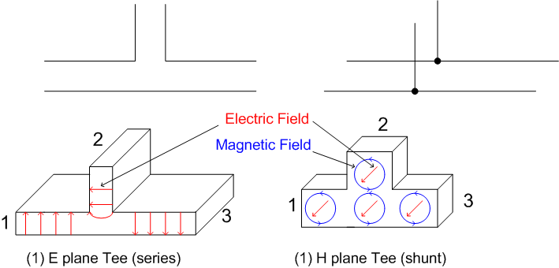
IIT Bombay
Page 2
E plane TeesTees
EE 611 Lecture 10 Jayanta Mukherjee
EE 611 Lecture 11 Jayanta Mukherjee

Slide 3
IIT Bombay
Page 3
E plane Tees
EE 611 Lecture 10 Jayanta Mukherjee
EE 611 Lecture 11 Jayanta Mukherjee

Slide 4
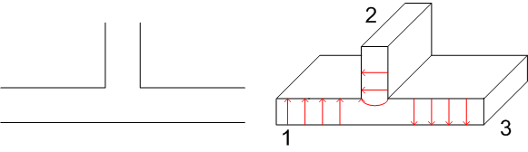
IIT Bombay
Page 4
E plane Tees
EE 611 Lecture 10 Jayanta Mukherjee
EE 611 Lecture 11 Jayanta Mukherjee

Slide 5
IIT Bombay
Page 5
E plane Tees
EE 611 Lecture 10 Jayanta Mukherjee
EE 611 Lecture 11 Jayanta Mukherjee

Slide 6
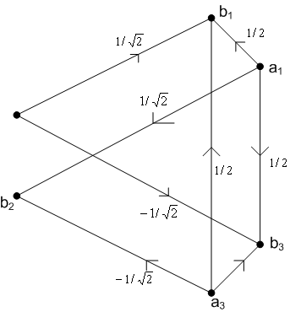
IIT Bombay
Page 6
E plane Tees
EE 611 Lecture 10 Jayanta Mukherjee
EE 611 Lecture 11 Jayanta Mukherjee

Slide 7
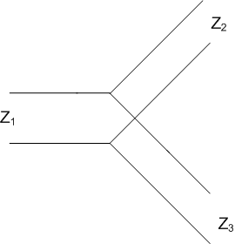
IIT Bombay
Page 7
Example
EE 611 Lecture 10 Jayanta Mukherjee
EE 611 Lecture 11 Jayanta Mukherjee

Slide 8
IIT Bombay
Page 8
Circulators
EE 611 Lecture 10 Jayanta Mukherjee
EE 611 Lecture 11 Jayanta Mukherjee

Slide 9
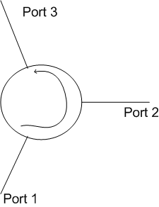
IIT Bombay
Page 9
Circulator S matrix
EE 611 Lecture 10 Jayanta Mukherjee
EE 611 Lecture 11 Jayanta Mukherjee

Slide 10
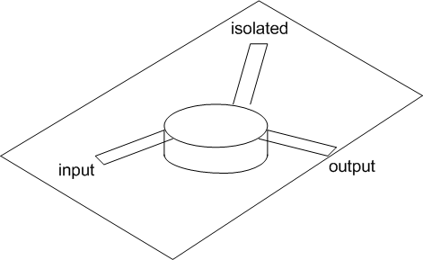
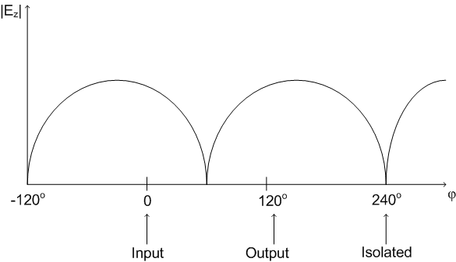
IIT Bombay
Page 10
Circulator S matrix
EE 611 Lecture 10 Jayanta Mukherjee
EE 611 Lecture 11 Jayanta Mukherjee

Slide 11
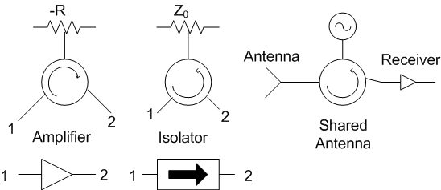
IIT Bombay
Page 11
Applications of Circulators
EE 611 Lecture 10 Jayanta Mukherjee
EE 611 Lecture 11 Jayanta Mukherjee

Slide 12
IIT Bombay
Page 11
Power Dividers
EE 611 Lecture 10 Jayanta Mukherjee
EE 611 Lecture 11 Jayanta Mukherjee

Slide 13
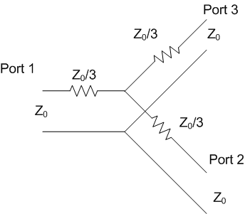
IIT Bombay
Page 13
Resistive Power Dividers
EE 611 Lecture 10 Jayanta Mukherjee
EE 611 Lecture 11 Jayanta Mukherjee

Slide 14
IIT Bombay
Page 14
Resistive Power Dividers
EE 611 Lecture 10 Jayanta Mukherjee
EE 611 Lecture 11 Jayanta Mukherjee

Slide 15
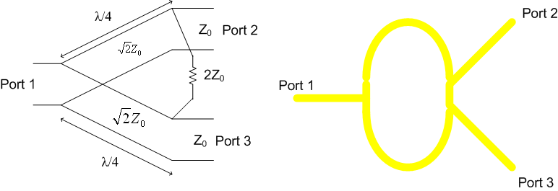
IIT Bombay
Page 15
Wilkinson Power Divider
EE 611 Lecture 10 Jayanta Mukherjee
EE 611 Lecture 11 Jayanta Mukherjee

Slide 16
IIT Bombay
Page 16
Wilkinson Power Divider Analysis
EE 611 Lecture 10 Jayanta Mukherjee
EE 611 Lecture 11 Jayanta Mukherjee

Slide 17
IIT Bombay
Page 17
Wilkinson Power Divider Analysis
EE 611 Lecture 10 Jayanta Mukherjee
EE 611 Lecture 11 Jayanta Mukherjee

Slide 18

IIT Bombay
Page 18
Wilkinson Power Divider Analysis
EE 611 Lecture 10 Jayanta Mukherjee
EE 611 Lecture 11 Jayanta Mukherjee

Slide 19
IIT Bombay
Page 19
Broadband Wilkinson Power Divider
EE 611 Lecture 10 Jayanta Mukherjee
EE 611 Lecture 11 Jayanta Mukherjee

Slide 20
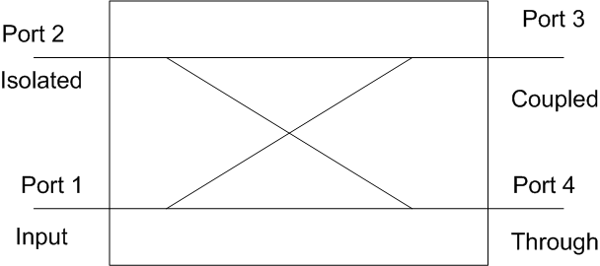
IIT Bombay
Page 20
General Definition
EE 611 Lecture 10 Jayanta Mukherjee
EE 611 Lecture 11 Jayanta Mukherjee

Slide 21
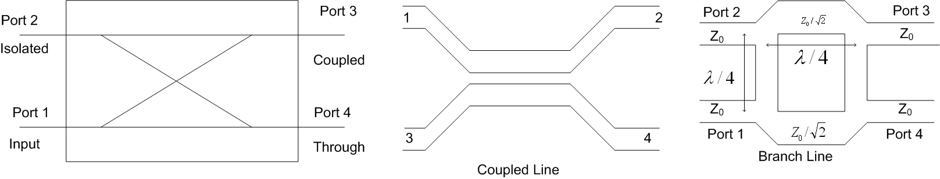
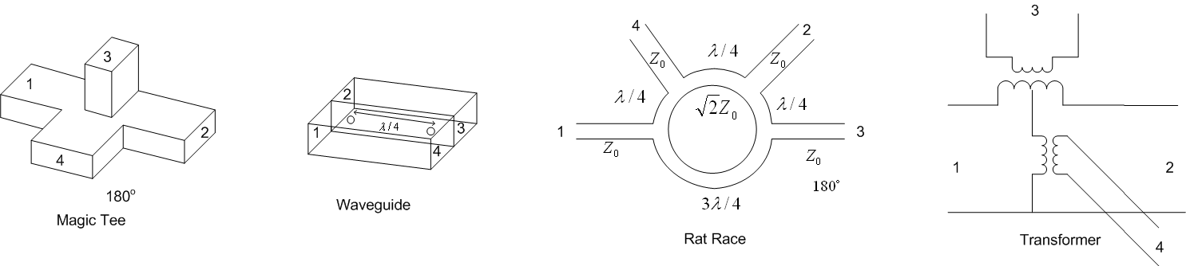
IIT Bombay
Page 21
General Definition
EE 611 Lecture 10 Jayanta Mukherjee
EE 611 Lecture 11 Jayanta Mukherjee

Slide 22
IIT Bombay
Page 22
General Definition
EE 611 Lecture 10 Jayanta Mukherjee
EE 611 Lecture 11 Jayanta Mukherjee

Slide 23
IIT Bombay
Page 23
General Properties of a coupler
EE 611 Lecture 10 Jayanta Mukherjee
EE 611 Lecture 11 Jayanta Mukherjee

Slide 24
IIT Bombay
Page 24
General Properties of a coupler
EE 611 Lecture 10 Jayanta Mukherjee
EE 611 Lecture 11 Jayanta Mukherjee

Slide 25
IIT Bombay
Page 25
General Properties of a coupler
EE 611 Lecture 10 Jayanta Mukherjee
EE 611 Lecture 11 Jayanta Mukherjee

